Slide 1
Overview of Clinical and Translational Science Awards (CTSA) Program
Michael Kurilla, MD, PhD Director, Division of Clinical Innovation
NCATS
December 7, 2023

Slide 2
NCATS Division of Clinical Innovation
Innovating Clinical and Translational Science
Plans, conducts, and supports research to develop new methods that enhance clinical processes
Plans, conducts, and supports research to evaluate existing approaches and technologies in the clinical spectrum
Allocates resources to clinical and translational infrastructure and investigators
Supports training programs relevant to clinical phases of translational science

Slide 3
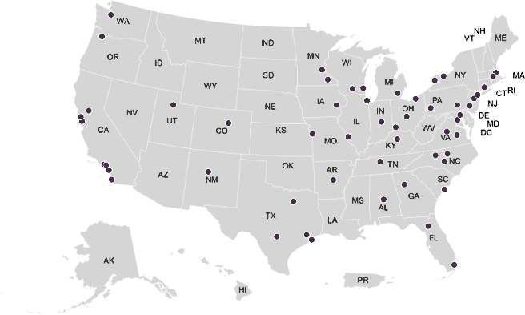
NCATS Clinical and Translational Science Awards (CTSA) Program
3
National network of medical research institutions and their partners/collaborators
In fiscal year 2023, NCATS invested $629M in the CTSA Program to speed translation of research discoveries into improved patient care
CTSA Program Hubs 9.30.2023

Slide 4
CTSA Program Focus
Develop, demonstrate, and disseminate innovations that turn science into health faster
Provide a national resource for the rapid response to urgent public health needs
Promote impactful partnerships and collaborations
Promote training and career support
Address health disparities
Nurture emerging field of translational science

Slide 5
Suite of CTSA NOFOs
REQUIRED
OPTIONAL
Post-doc (T32)
CTSA Hub Grants to Medical Research Institution(s) (UM1)
+
High Impact Specialized Innovation (RC2)
Pre-doc (T32)
Institutional Mentored Career Dev Program (K12)
Short-term (R25)
IDENTIFICATION
of processes & innovations that feed CTS
DEVELOPMENT
of new approaches, technologies, resources and models
DEMONSTRATION
of their utility
DISSEMINATION
of the data, analysis and methodologies to the community

Slide 6
CTSA NOFOs
REQUIRED
OPTIONAL
Post-doc (T32)
CTSA Hub Grants to Medical Research Institution(s) (UM1)
+
High Impact Specialized Innovation (RC2)
Pre-doc (T32)
Institutional Mentored Career Dev Program (K12)
Short-term (R25)
IDENTIFICATION
of processes & innovations that feed CTS
DEVELOPMENT
of new approaches, technologies, resources and models
DEMONSTRATION
of their utility
DISSEMINATION
of the data, analysis and methodologies to the community

Slide 7
Limited Competition: High Impact Specialized Innovation Programs in Clinical and Translational Science for UM1 CTSA Hub Awards
(RC2 Clinical Trials Optional)
PAR-24-054
Reissue of PAR-21-340
Pablo Cure, M.D., M.P.H, Program
Erin Davis, M.B.A., Grants Management Nichol Cleveland, M.Ed., Grants Management Jing Chen, Ph.D., Scientific Review
Victor Henriquez, Ph.D., Scientific Review
December 7, 2023
During this presentation, please send your questions to: RC2NOFO@nih.gov

Slide 8
What's new?
Clinical Trials Optional
Impact Statement
New Attachments
NOFO specific review criteria
Please send your questions to: RC2NOFO@nih.gov

Slide 9
Overview
9
Purpose, Description, Scope and Examples
Application Types Allowed & Instructions
Eligibility Information
Research Strategy
Award Budget and Project Period
Other Attachments
Review & selection process
Important Dates
Contacts and Resources
FAQs and Live Questions
Please send your questions to: RC2NOFO@nih.gov

Slide 10
The Suite of CTSA NOFOs
REQUIRED
OPTIONAL
Post-doc (T32)
CTSA Hub Grants to Medical Research Institution(s) (UM1)
+
High Impact Specialized Innovation (RC2)
Pre-doc (T32)
Institutional Mentored Career Dev Program (K12)
Short-term (R25)
IDENTIFICATION
of processes & innovations that feed CTS
DEVELOPMENT
of new approaches, technologies, resources and models
DEMONSTRATION
of their utility
DISSEMINATION
of the data, analysis and methodologies to the community

Slide 11
Purpose
11
The purpose of the High Impact Specialized Innovation Programs (SIPs) is to support unique activities, resources, capabilities and/or expertise at awarded CTSA UM1 (PAR-21-293) hubs to help advance one or more of the NCATS CTSA Program goals. The SIPs initiative is envisioned as part of the current innovation ecosystem to support the generation of a research resource and/or foster discovery-based or hypothesis-generating science that can have a significant impact in Clinical and Translational Science (CTS). Specifically, this NOFO seeks to support novel approaches in areas that address specific knowledge gaps, scientific opportunities, new technologies/platforms, data generation and/or analysis, or novel research methods that will advance clinical and translational science (CTS) and research (CTR) at CTSA UM1 hubs.
https://grants.nih.gov/grants/guide/pa-files/PAR-24-054.html

Slide 12
Funding Opportunity Description
SIPs are expected to have a significant impact on Clinical and Translational Science (CTS).
Address specific knowledge gaps that will advance clinical and translational science (CTS) and research (CTR) at CTSA UM1 hubs.
Resources, activities, and expertise supported through the RC2 mechanism are expected to enhance the development and demonstration activities or projects within a CTSA hub.
Highly useful and transformative to the broader clinical and translational science community.

Slide 13
Examples of SIPs
Digital Health
Decentralized trials
Telehealth
Pragmatic trials
AI/ML algorithms in medicine
Decision support systems
Data science and novel statistical methods
RWD/RWE
Innovative CT designs
Genetics and genomics
Other areas of need for specialized programs

Slide 14
Scope and Specific Requirements:
SIPs should address one or more of the following objectives:
Groundbreaking, innovative, high impact and cross-cutting research, resources and/or activities that address one or more of the CTSA Program Goals and have the highest potential to improve and accelerate biomedical research.
Programs in Clinical and Translational Science that could fundamentally enhance the research enterprise and that require the participation, interaction, coordination, and integration of activities within a CTSA UM1 hub .
Creation of unique resources and/or development of transformative technologies and/or platforms that can benefit a wide range of projects and/or activities at CTSA UM1 hubs.
High-impact discovery-based projects or hypothesis-generating science.
Inclusion of preliminary data in the applications is allowed, but not required.
Potential applicants are highly encouraged to contact NCATS Scientific/Research Contacts listed in this NOFO to discuss the scope of the project, required materials, responsiveness, and clinical trials status designation prior to submission of an application.
Collaborations with other components of the CTSA UM1 hub and/or with institutions listed as partners and/or collaborators are encouraged. Also, collaborations with other CTSA UM1 and UL1 hubs and with non-CTSA organizations are encouraged.

Slide 15
Application Types Allowed and Instructions
15
New
Resubmission
Clinical Trial? Optional. Need help determining whether you are doing a clinical trial?
Application Instructions: It is critical that applicants follow the instructions in the Research (R) Instructions in the SF424 (R&R) Application Guide, except where instructed to do otherwise (in this NOFO or in a Notice from NIH Guide for Grants and Contracts).
Applicants are encouraged to consult with Program Officials at NCATS on whether their study meets the definition of a clinical trial or not before submission.

Slide 16
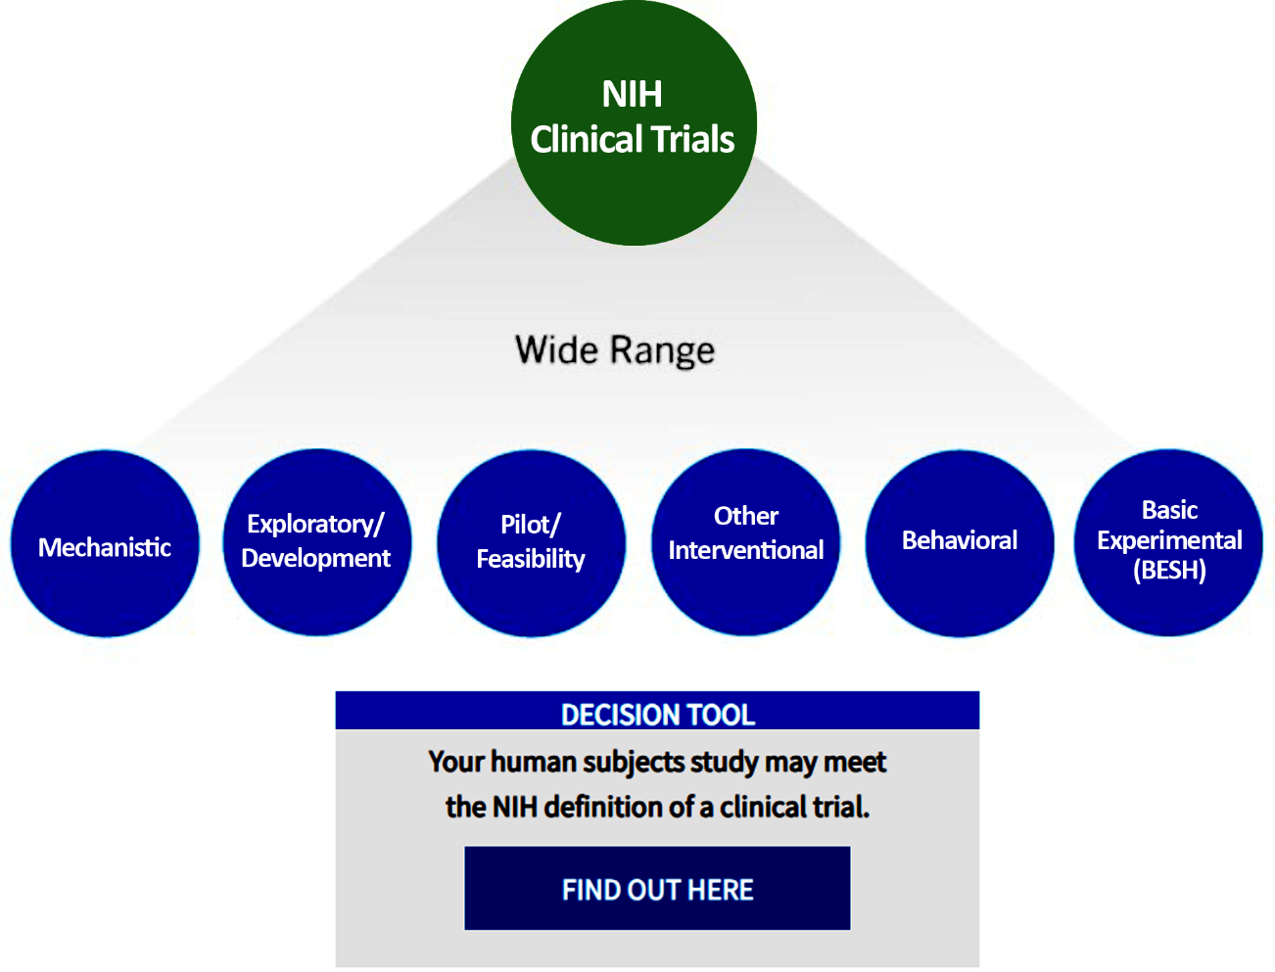
PAR-24-054 (RC2 Clinical Trial Optional)
A wide-range of clinical research can fit NIH’s definition of a clinical trial.
See NIH’s definition of a clinical trial.
Leverage NIH’s decision tool.
Misclassified clinical trial applications may be withdrawn.
Note: NIH Clinical Trial-Specific Review Criteria Policy: The goal of this policy is to ensure that key pieces of clinical trial-specific information are submitted with each application and that reviewers appropriately consider this clinical trial-related information.
Sources:
https://grants.nih.gov/policy/clinical-trials/definition.htm https://grants.nih.gov/policy/clinical-trials/review-criteria.htm

Slide 17
Eligibility
17
All applicant organizations and/or active award recipients for PAR-21-293 Clinical and Translational Science Award (UM1 Clinical Trial Optional) are eligible to apply under this NOFO.
Only the primary UM1 CTSA program hub organization is eligible to apply (not partner or collaborator institutions).
RC2 companion optional applications may be submitted under the following scenarios:
concurrently with the UM1
while the UM1 application is under review consideration
after the UM1 application is funded
while the UM1 is under consideration for funding
RC2 applications will only be awarded if there is an awarded UM1 application from the RC2 applicant organization.

Slide 18
Additional Information on Eligibility
UM1 hub institution can submit up to two RC2 applications for SIPs per cycle as the primary institution.
A UM1 hub may have up to two RC2 SIPs awards as the primary recipient.
A RC2 in extension period counts towards the maximum of two RC2s that may be awarded.
A UM1 hub that is in an extension period is not allowed to submit RC2s as the primary recipient unless a pending UM1 application has been submitted or is under review or under funding consideration.
Resubmission of a RC2 application without the required UM1 application is only allowed if the UM1 application is awarded.

Slide 19
Eligible Individuals (PD/PI)
19
The PD/PI or contact PD/PI must be employed by and/or a recipient of funding and/or have an academic appointment from a CTSA Program UM1 hub prime institution as defined above in Eligible Organizations.
Investigators from UM1 hub partners or collaborators who wish to co- lead a SIP, can co-direct in partnership with a contact PD/PI who is employed by and/or a recipient of funding and/or has an academic appointment at a CTSA Program UM1 prime hub institution using the multiple PD/PI option.

Slide 20
Research Strategy key points
20
Critical Need/Gap Area Addressed:
Describe how the proposed project is unique and how it is expected to solve a real gap or overcome a key roadblock in clinical and translational science. It is expected that the capability or resource will be in an area of need where there are currently no clearly available solutions/tools/resources or where the existing solutions are suboptimal.
Impact:
How the proposed RC2 could impact health and medicine?
If successful, how the proposed RC2 could be more broadly disseminated?
How does it change the landscape in CTS?

Slide 21
Programs are expected to demonstrate the following:
Work cannot be reasonably expected to be carried out successfully without support provided by this NOFO.
Promote and advance the NCATS Strategic Plan and, specifically addresses one or more of the CTSA Program Goals.
Accelerate the development of innovative resources, approaches, tools, solutions, therapies, diagnostics, devices and/or apps.
Catalyze clinical and translational science locally at UM1 hubs
Generated results and resources are expected to become integrated into the broader clinical and translational science community locally, regionally and/or nationally.
Plan for sustainability of applicable research efforts and resources beyond the RC2 funding.

Slide 22
Award Budget and Project Period
22
Application budgets are limited to no more than $500,000/year in direct costs excluding consortium/contractual F&A costs.
It is recommended that the contact PD/PI devote at least one to two person months of their efforts to the project. No overlap of time or effort between this award and separately funded projects is permitted.
Consultants and any associated costs (consultant fees, per diem, travel) may be included when their services are required and justified within the award.
RC2 budget should include travel expenses for appropriate personnel (up to three people) to attend a yearly in-person meeting to present RC2 progress, lessons learned and impact.
Requested project period may be up to 5 years.

Slide 23
SF424(R&R) Other Project Information
Attachment 1 (Up to 2 pages) “UM1 and RC2 Coordination and Integration Plan”
Attachment 2 (Up to 1 page) “RC2 Program Milestones”
Attachment 3 (Up to 2 pages) “Program Evaluation and Sustainability Plan”
Applications that do not include one or more of these attachments will be considered incomplete and will not be reviewed.

Slide 24
Attachment 1:
UM1 and RC2 Coordination and Integration Plan
Applicants must provide a specific plan describing the collaboration, support, equipment, coordination, synergy and integration between the UM1 hub and any of its elements and modules and other UM1 companion NOFOs and the proposed RC2 Program.

Slide 25
Attachment 2: Program Milestones
Applicants must include a table with key milestones to be achieved throughout the RC2 program period. Both short- term/interim (monthly or quarterly) and long-term (yearly) milestones should be clearly outlined in word table format. Each milestone should be constructed to succinctly include: (a) the goals and timeline for completion, (b) the criteria for success, including quantitative and/or qualitative metrics that will be used to assess success.

Slide 26
Attachment 3:
Program Evaluation and Sustainability Plan
Applicants must provide a clear plan to evaluate the success and impact of the proposed program based on the pre- determined milestones and SIP utilization.
List key metrics and measures of success to be utilized to evaluate the overall impact of the program and how success will be measured in an objective and tangible manner on a regular basis.
In addition, outline plans for sustainability of the SIP beyond the RC2 grant period (once grant funding ends) and how do applicants envision their Specialized Innovation Program to continue through partnerships, collaborations, support, etc. after the RC2 ends.

Slide 27
Applications Not Responsive
The following types of applications will be deemed nonresponsive and will not be reviewed:
Applications that propose:
Feasibility/Pilot projects
Dissemination and implementation of novel resources/activities/projects at other hubs.
Ancillary studies or research that is a logical extension of ongoing work.
Core (or related) services to supplement the budgets of existing UM1 efforts.
Applications with Studies with a major emphasis outside of the NCATS Strategic Plan and the goals of the CTSA Program.

Slide 28
Incomplete applications
Applications that do not include:
UM1 and RC2 Coordination and Integration Plan
Program Milestones
Program Evaluation and Sustainability Plan
Letter of Support from UM1 PD/PI
Will not be reviewed.

Slide 29
Review and Selection Process
29
Applications will be evaluated for scientific and technical merit by (an) appropriate Scientific Review Group(s) convened by NCATS, in accordance with NIH peer review policy and procedures, using the stated review criteria. Assignment to a Scientific Review Group will be shown in the eRA Commons.
As part of the scientific peer review, all applications will receive a written critique.
Applications may undergo a selection process in which only those applications deemed to have the highest scientific and technical merit (generally the top half of applications under review) will be discussed and assigned an overall impact score.
The following will be considered in making funding decisions:
UM1 parent application funding determination.
Scientific and technical merit of the proposed project as determined by scientific peer review.
Availability of funds.
Relevance of the proposed project to CTSA program priorities.

Slide 30
Important Dates
30
Application Due Dates
Review and Award Cycles
New | Renewal / Resubmission / Revision (as allowed) | AIDS - New/Renewal/Resub mission/Revision, as allowed | Scientific Merit Review | Advisory Council Review | Earliest Start Date
January 12, 2024 | January 12, 2024 | Not Applicable | June 2024 | October 2024 | December 2024
May 17, 2024 | May 17, 2024 | Not Applicable | October 2024 | January 2025 | April 2025
September 13, 2024 | September 13, 2024 | Not Applicable | March 2025 | May 2025 | July 2025
January 13, 2025 | January 13, 2025 | Not Applicable | June 2025 | October 2025 | December 2025
May 19, 2025 | May 19, 2025 | Not Applicable | October 2025 | January 2026 | April 2026
September 15, 2025 | September 15, 2025 | Not Applicable | March 2026 | May 2026 | July 2026
January 13, 2026 | January 13, 2026 | Not Applicable | June 2026 | October 2026 | December 2026
May 18, 2026 | May 18, 2026 | Not Applicable | October 2026 | January 2027 | April 2027
September 14, 2026 | September 14, 2026 | Not Applicable | March 2027 | May 2027 | July 2027
All applications are due by 5:00 PM local time of applicant organization.

Slide 31
Contacts
31
Scientific/Research Contact(s)
Pablo Cure, M.D., M.P.H., Program
National Center for Advancing Translational Sciences (NCATS) Telephone: 301-827-2014
Email: RC2NOFO@nih.gov
Peer Review Contact(s)
Victor Henriquez, Ph.D., Scientific Review Branch
National Center for Advancing Translational Sciences (NCATS) Telephone: 301-435-0814
Email: RC2NOFO@nih.gov
Financial/Grants Management Contact(s)
Nichol Cleveland, M.Ed., Grants Management Branch (NCATS) National Center for Advancing Translational Sciences (NCATS) Telephone: 301-451-6331
Email: RC2NOFO@nih.gov

Slide 32
Resources
32
High Impact Specialized Innovation Program Reissue: https://grants.nih.gov/grants/guide/pa-files/PAR-24-054.html
Clinical and Translational Science Award (UM1 Clinical Trial Optional): https://grants.nih.gov/grants/guide/pa-files/PAR-21- 293.html
RC2 FAQs (under RC2 Companion Application): https://ncats.nih.gov/ctsa/funding/application-information-par-21- 293

Slide 33
Questions?

Slide 34
NCATS contact information
ncats.nih.gov
@ncats_nih_gov
@ncats.nih.gov
NIH-NCATS

