Slide 1



NCATS Year in Review
Reflecting on Our 2019 Activities

Slide 2

By joining forces with a diverse set of partners, we advanced the conversation on important issues to accelerate scientific progress.

Slide 3

Who Are Translational Scientists?
New resources describe these scientists’ fundamental characteristics and critical role in accelerating research—and encourage careers in this young field.
Video and Interactive Graphic
Director’s Message

Slide 4

Ask an Astronaut!
Children receiving care at NIH talked to an astronaut on the International Space Station about science in space. They learned how projects like our tissue chips can help improve health on earth.
Event Details
Director’s Message
Tissue Chips in Space

Slide 5
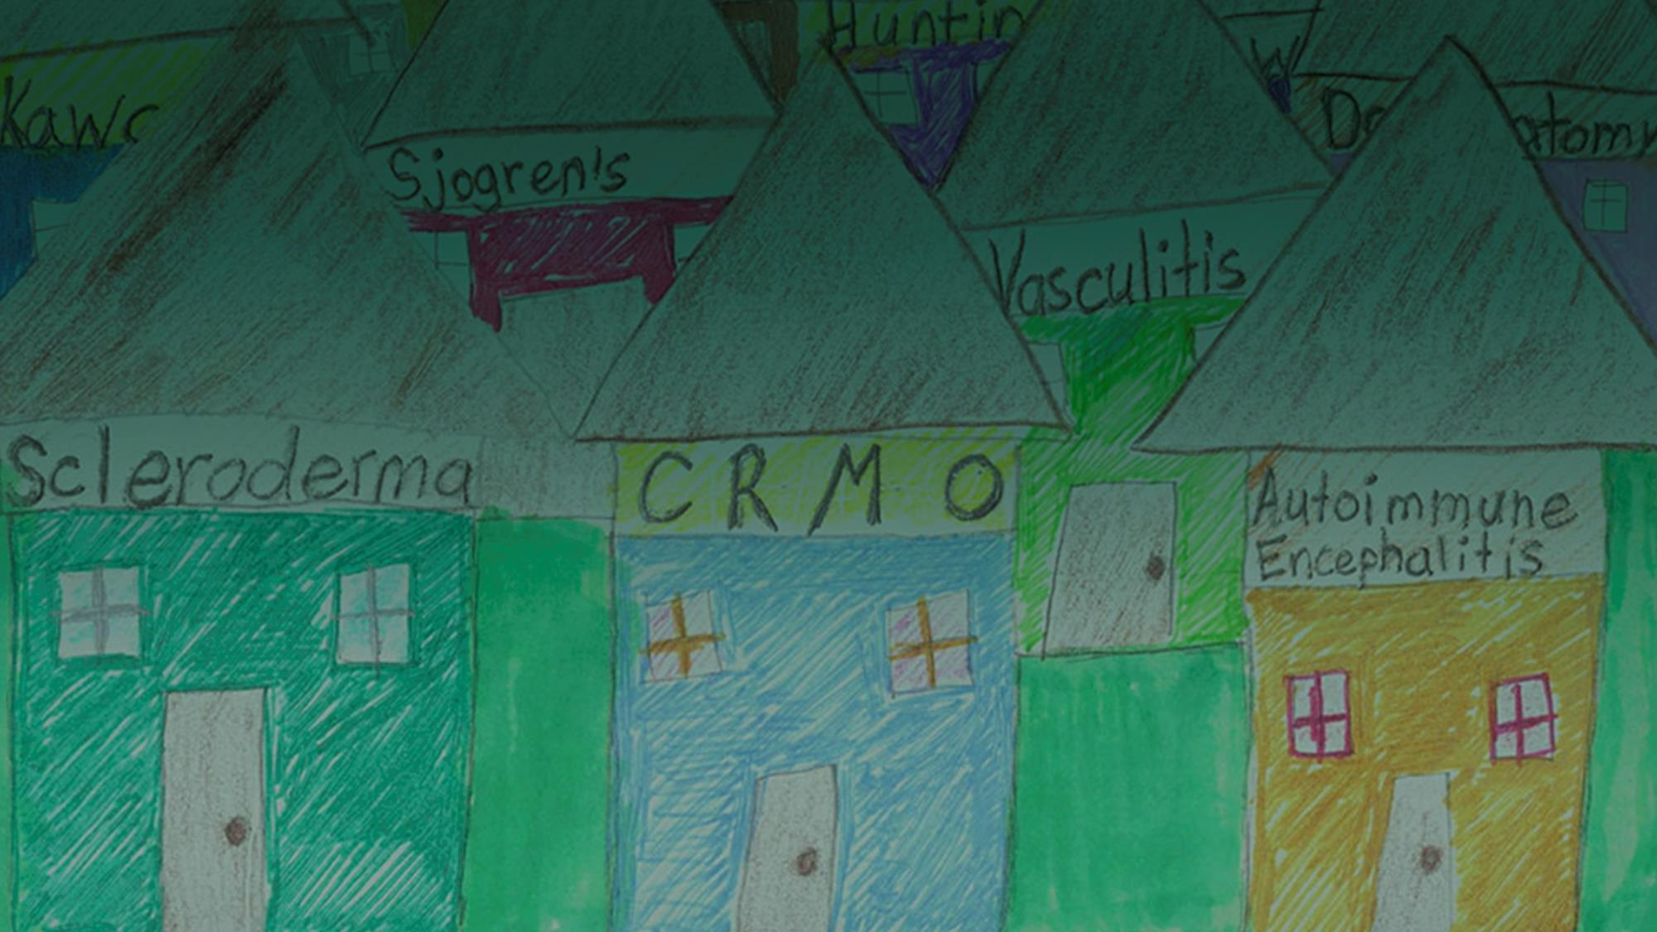
Rare Diseases Are Not Rare
Our nationwide prize competition raised awareness about rare diseases and the need for expanded research and patient support.
Prize Winners
Rare Diseases
Director’s Message

Slide 6

Addressing the Opioid Crisis
Through new awards, researchers are applying translational science approaches to speed scientific solutions that address the opioid public health crisis.
NCATS Initiatives
Director’s Message
Symposium

Slide 7

Collaboration in the Cloud
Our secure cloud computing environment enabled research teams to look across a robust, interconnected ecosystem
of data to make new discoveries, including a promising
drug combination against lethal childhood brain cancers.
Research Insights

Slide 8

The Promise of Machine Intelligence
We gathered experts in machine intelligence to share their perspectives on current issues associated with incorporating MI systems into health care settings.
Workshop

Slide 9

Improving Rural Health Outcomes
We explored how innovations in clinical and translational science could improve rural health outcomes during the Inaugural NIH Rural Health Seminar.
Event and Highlighted Projects
Director’s Message

Slide 10
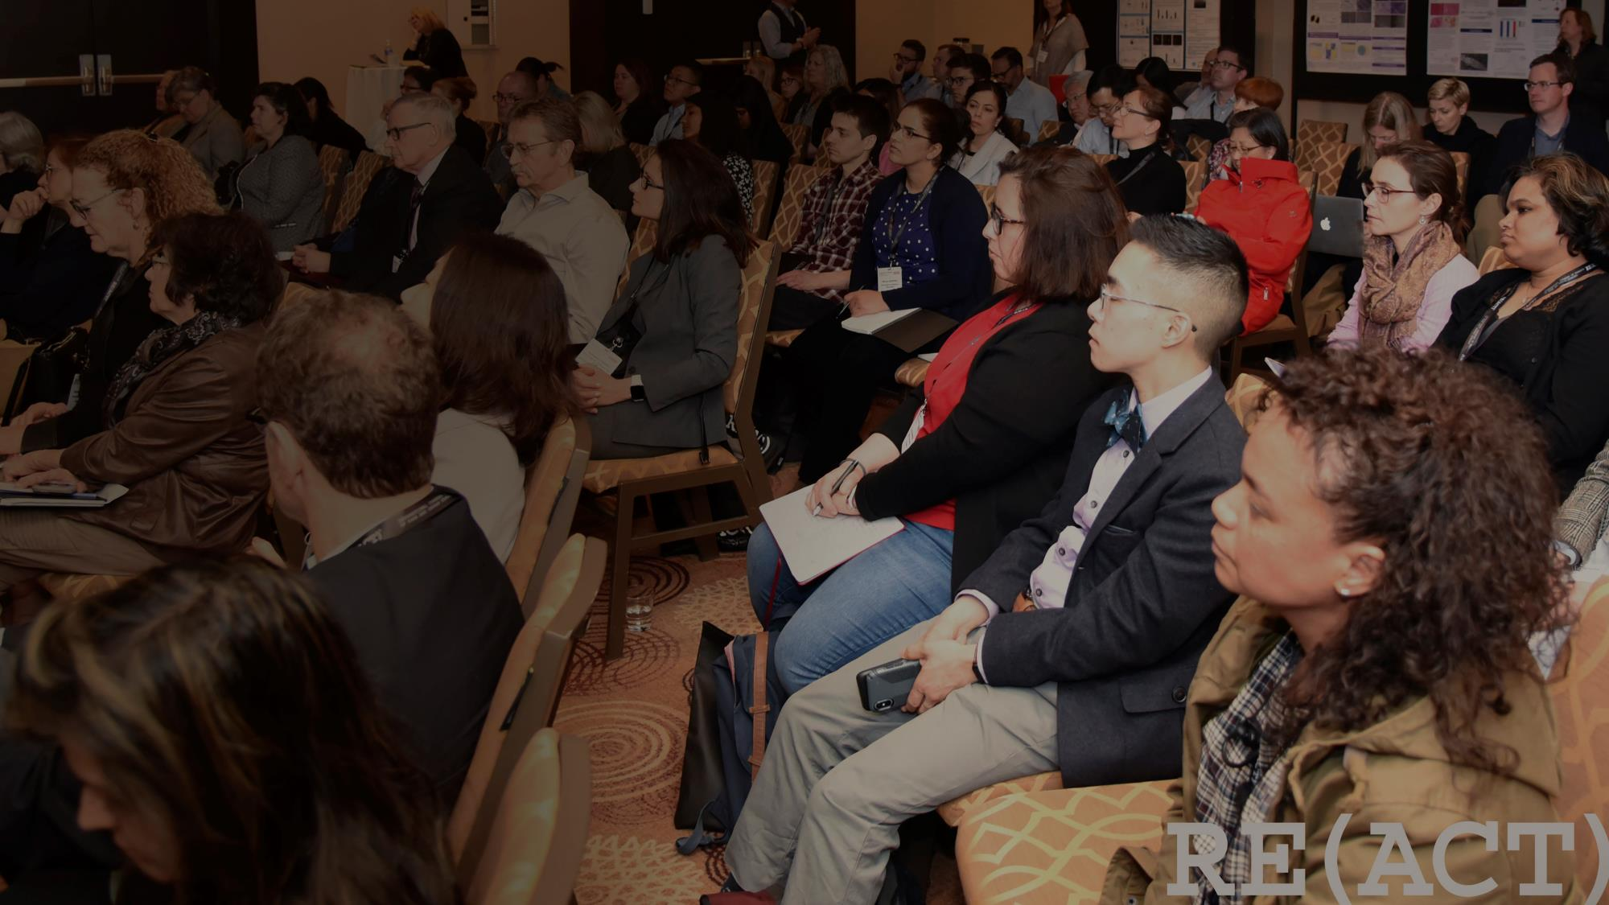
Collective Action for Research on Rare Diseases
Collaborating with international rare disease advocates, we co-sponsored the first RE(ACT) Congress in North America to promote scientific cooperation and research on rare and orphan diseases.
RE(ACT) 2019 Congress

Slide 11

Exploring the Drug Repurposing Landscape
Stakeholders with a range of expertise discussed research and regulatory challenges to finding new uses for existing drugs and, together, captured possible solutions.
Workshop

Slide 12
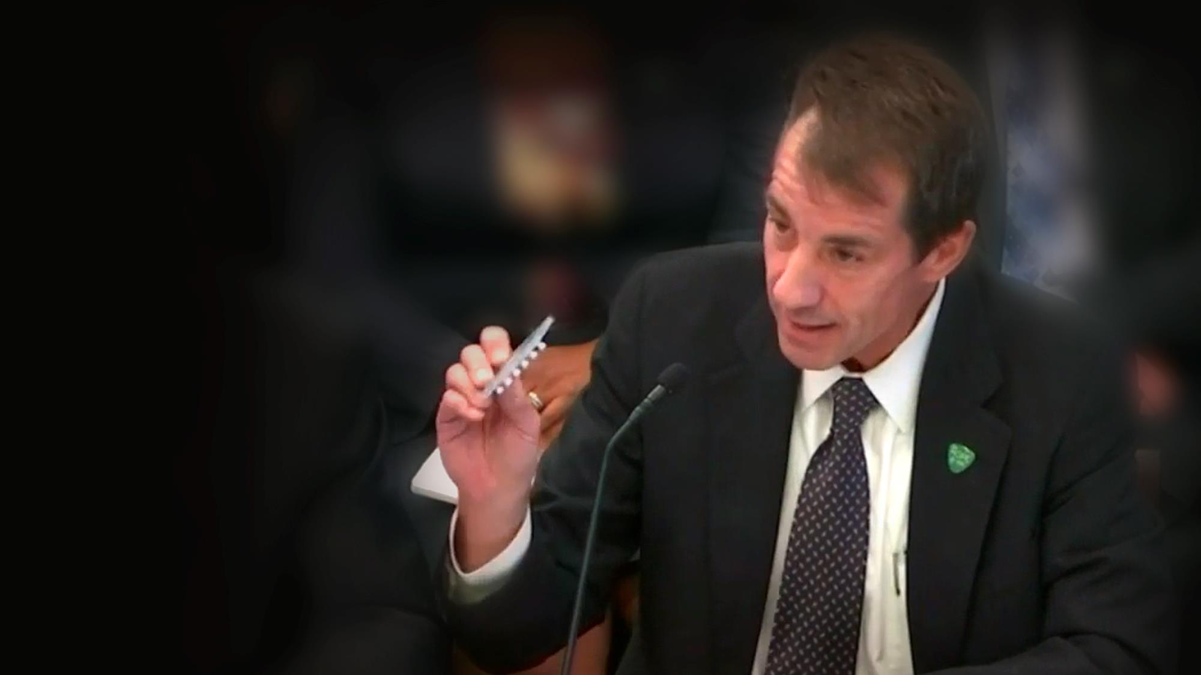
Planning for the Future
We discussed ongoing and future initiatives with Congressional leaders who set the annual budget for NIH.
Statement for the Record
NCATS Budget Information

Slide 13






Connect with Us
Stay up-to-date on all our activities!

